Slide 1

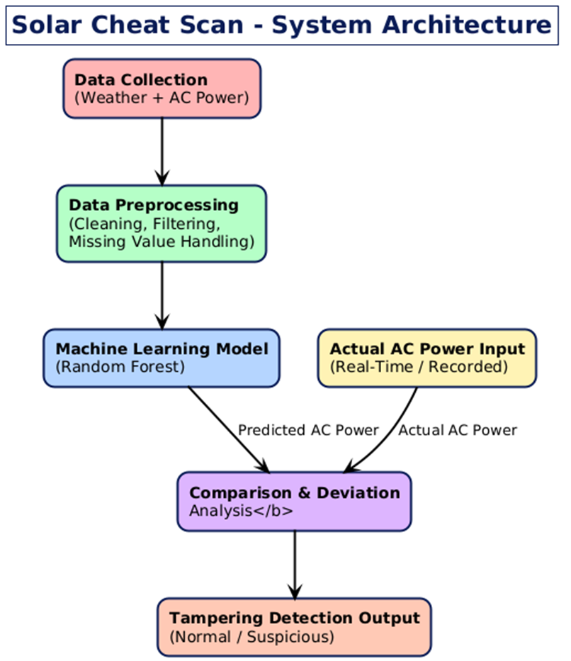
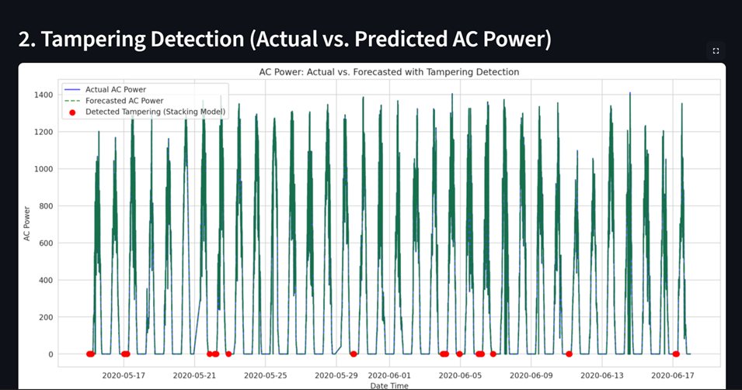

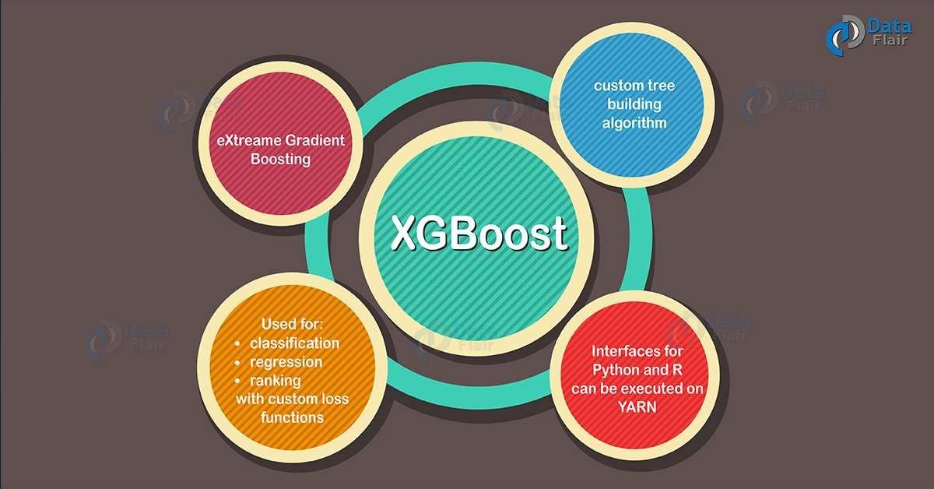



SR UNIVERSITY School of Computer Science & Artificial Intelligence (CS&AI)
SOLAR CHEAT SCAN : DETECTION OF TAMPERING OF SOLAR FORECASTING USING ML ALGORITHMS.
Mohammad Samreen (2203A51829)
Annam Varshini (2203A51830) Rangi Vani priya (2203A51441) Devireddy Vinisha(2203A51200) Moola Harshitha (2203A51430)
Under the guidance of Dr. V. Venkataramana Professor, School of CS&AI, SR University
Abstract
PROBLEM STATEMENT & OBJECTIVES
This project presents a machine-learning framework designed to ensure accurate and tamper-free solar power forecasting. As solar energy becomes essential for grid stability and sustainable power management, any manipulation or errors in forecast data can lead to operational failures, financial losses, and unreliable energy decisions. To address this, the system uses historical weather data and AC power records to train models such as Random Forest, Gradient Boosting, XGBoost, and a Stacking Model to predict expected solar output. By comparing predicted values with actual measurements, the system identifies anomalies or unusual deviations that indicate possible tampering.
Model performance is evaluated using MAE, RMSE, and R² Score for forecasting accuracy and Accuracy, Precision, Recall, and F1-Score for tampering detection. Results show that the Stacking Model performs best, offering strong prediction reliability and effective detection of manipulated forecast data. Overall, this project enhances data integrity, real-time monitoring, and operational transparency, helping build a more secure and trustworthy solar energy system.
Problem Statement:
Solar power forecasting plays a crucial role in grid stability and energy planning, but the data used for these predictions is often affected by sensor faults, transmission errors, or intentional tampering. Such manipulated data leads to inaccurate forecasts, operational risks, and financial losses. Existing rule-based systems cannot effectively detect complex anomalies in solar data, creating a need for an intelligent and reliable tampering-detection solution.
Objectives:
• Develop an ML-based system to detect tampered or anomalous solar forecast data. • Collect, preprocess, and structure real and forecasted AC power data for accurate model training. • Predict AC power output using models such as Random Forest, Gradient Boosting, and XGBoost. • Compare predicted vs. actual AC power values to identify abnormal deviations. • Visualize predictions and anomalies using graphs for better interpretability.
SYSTEM ARCHITECTURE / WORKFLOW
MAJOR MODULES
Data Layer: Collects solar AC power and weather data from sensors.
Preprocessing Layer: Cleans data, aligns timestamps, and creates features.
Forecasting Layer: ML models (RF, GBM, XGBoost, Stacking) predict expected AC power.
Tampering Detection Layer: Compares predicted vs actual values to flag anomalies using classification models.
Evaluation Layer: Uses MAE, RMSE, R², Accuracy, Precision, Recall, F1-Score to assess performance.
Visualization Layer: Dashboard shows predictions, anomalies, and future forecasts.
Workflow Summary:
Data collected → cleaned → model predicts AC power → predicted vs actual compared → deviations analyzed → tampering detected → results visualized on dashboard.
Data Collection Module: Gathers AC power output and weather data (irradiance, temperature, humidity, wind speed). • Data Preprocessing Module: Cleans data, fixes missing values, aligns timestamps, and prepares features. • Power Forecasting Module: Predicts AC power using Random Forest, Gradient Boosting, XGBoost, and Stacking models. • Tampering Detection Module: Compares predicted vs actual values and identifies abnormal or tampered data. • Evaluation Module: Uses MAE, RMSE, R², Accuracy, Precision, Recall, and F1-Score to measure model performance. • Visualization Module: Displays graphs, anomalies, deviations, and summary insights through an interactive dashboard.
TECHNOLOGIES USED
CONCLUSION & FUTURE WORK
Conclusion
The Solar Cheat Scan project successfully demonstrates an intelligent and reliable machine learning–based framework for ensuring the accuracy and integrity of solar power forecasting. By combining advanced regression models with anomaly-detection classifiers, the system can accurately predict AC power output and effectively identify tampered or abnormal data points. The integration of weather parameters, historical generation data, and feature engineering allows the models to learn complex patterns that traditional rule-based methods cannot capture. As a result, the system enhances trust, transparency, and stability in solar energy operations, which are essential for modern power grids relying on renewable energy sources.
Overall, the project delivers a scalable and practical approach for monitoring solar forecast data with improved accuracy and real-time usability. The forecasting results, tamper-detection labels, and visual dashboards together provide users with actionable insights that support better decision-making and operational efficiency in solar power management.

